Slide 1
Assembler directives IN ARM7
Shriram k vasudevan

Slide 2
Why and what?
Few assembly language instructions does not get transferred to machine language (i.e. the hex).
Why? And what is this for?
They are called directives.
They do the following:
Assign program to certain area of memory.
Designate areas of memory for data storage.
Allow references and
Housekeeping ☺

Slide 3
Most common directives
Define constant
Equate
Area
Define Storage
House keeping assembler directives:
END LIST FORMAT TTL PAGE INCLUDE

Slide 4
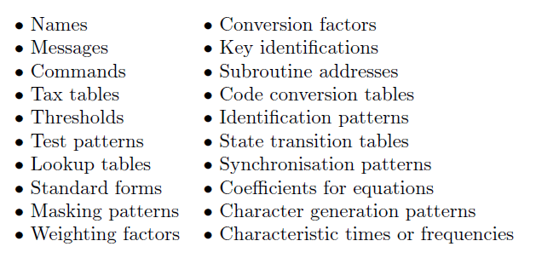
Define constant
Allows programmer to enter fixed data into the program memory.
Data can be any of these!
The data treated as permanent part of the program. (Can you understand??)
Format: DZCON DCW 12, this will place 12 in the next available memory location.

Slide 5
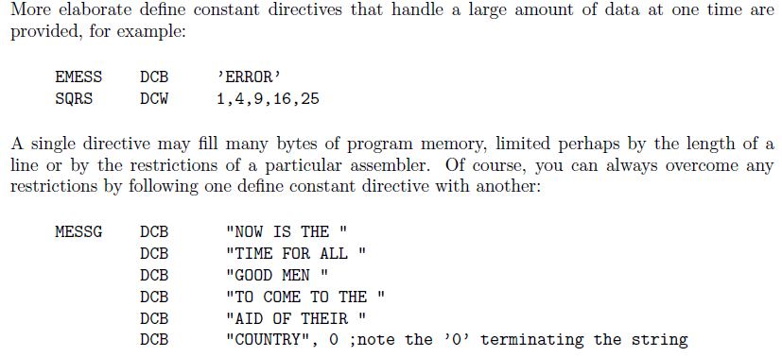
Contd.,

Slide 6
Contd.,
Define Byte – DCB – 8 Bit numbers
Define Word – DCW – 32 Bit numbers or Addresses.
DCD – Define constant data – Can be used for DCW.

Slide 7

16 bit operation in ARM
; 16 bit data transfer happens here.
TTL 16bitdatatransfer
AREA program, CODE, READONLY
; AREA is a directive which helps in specifying region where the code has
; to be stored. Here it is RESET. it can be PROGRAM also.
ENTRY
Main
LDRB R1, Value ; Loading the value to be moved.
STR R1, Result ; Store it back.
SWI &11 ; Software Interrupt instead of loop option seen earlier.
Value DCW &C123
ALIGN ; This will support 16 bit execution in ARM mode.
Result DCW 0 ; Storage
END

Slide 8
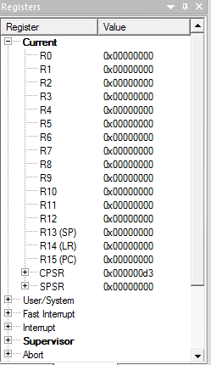
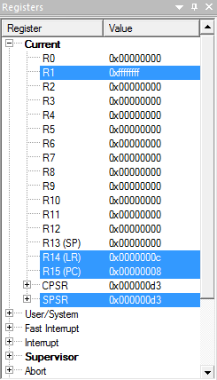
A Simple One’s complement in a different way.
; Ones complement Example.
TTL onescomplement
AREA program, CODE, READONLY
; AREA is a directive which helps in specifying region where the code has
; to be stored. Here it is RESET. it can be PROGRAM also.
ENTRY
Main
LDRB R1, Value ; Loading the value to be complemented.
MVN R1, R1 ; See the way I used R1 and R1. MVN is NOT.
SWI &11 ; Software Interrupt instead of loop option seen earlier.
Value DCW &0000
ALIGN ; This will support 16 bit execution in ARM mode.
END
Before Execution
After Execution

Slide 9
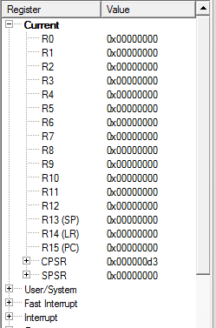
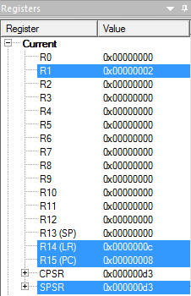
Shift Left One Bit.
; Shift Left One Bit!
TTL shift left one bit
AREA RESET, CODE, READONLY
; AREA is a directive which helps in specifying region where the code
; has to be stored. Here it is RESET. it can be PROGRAM also.
ENTRY
Main
LDRB R1, Value ; Loading the value to be complemented.
MOV R1, R1, LSL#0X1 ; one bit shift.
SWI &11
Value DCD &0001
END
Before Execution
After Execution

Slide 10
The equate directive
Allows equating names with address or data. (Just like your name with register number)
Names may be device address, numeric data, starting address, fixed address etc.
Example:
TTY EQU 100
LAST EQU 105
This is also possible : LAST EQU FINAL

Slide 11
Contd.,
This does not cause anything to be placed in memory. (Remember)
Instead additional name will be entered in the table (called symbol table)
Where can we use names?
Simple. Like DELAY, OPEN, KBD etc.
Mention the start of the program, location to hold some special data.

Slide 12
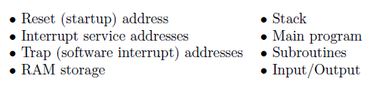
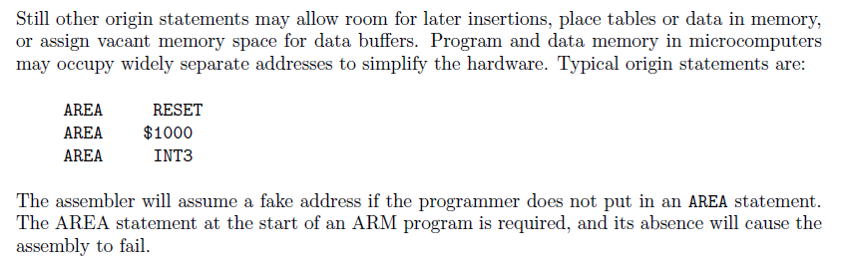
Area directive
Allows programmer to specify where programs, subroutines or data will reside.
Assembler has a location counter (remember program counter)
Many AREA directives available and supported as,

Slide 13
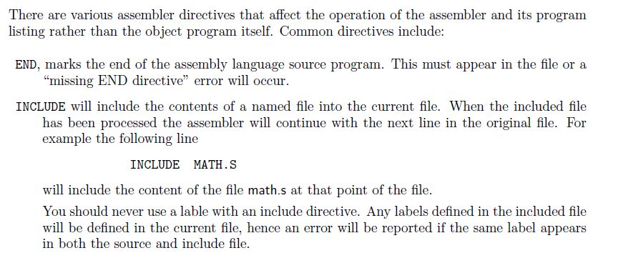
Housekeeping

Slide 14
Lets move to the next topic
Shriram k v

